Slide 1


Roll No: 23P81A0578
Generative AI for Cyber Threat-hunting in
6G-enabled IOT Networks
Project Overview:
This project builds a GAN + Transformer–based cyber threat-hunting system for 6G-enabled IoT networks. GANs generate synthetic attack data to balance the dataset, and a Transformer model classifies IoT attacks with high accuracy. Using the Edge-IIOT dataset, the system achieves good accuracy in identifying 14 different attack types. The approach improves real-time threat detection in large, high-speed 6G IoT environments while addressing challenges such as scalability, data quality, privacy, and energy consumption.

Slide 2
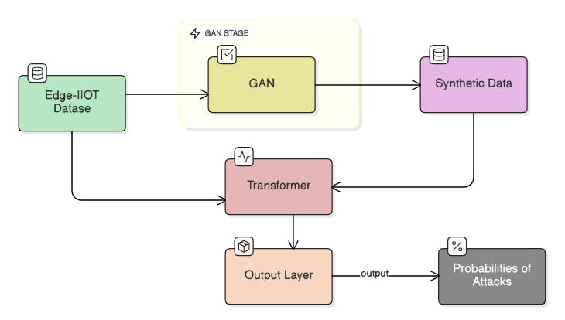
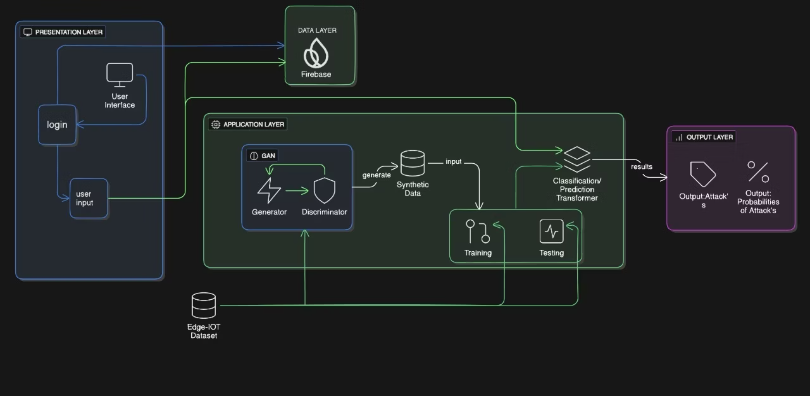
System Architecture:
Data Flow :

Slide 3














Technology stack and Development :
Programming Languages
ML/DL Frameworks
scikit-learn
TensorFlow
Pickle
Pandas
NumPy
Development Tools
Database & Deployment

Slide 4

Mathematical Foundation:
Core Mathematical Formulas:
Transformer:
Discriminator Loss | L(D) = −(log(D(x)) + log(1 − D(G(z))))
Generator Loss | L(G) = −log(D(G(z)))
Scaled dot-product attention | Att(Q,K,V)= softmax(QK^T/√d_k)V
Multi-Head Attention mechanism | MultiHead(Q,K,V)=Concat(h1​,h_h​)W^O
Feed-Forward Network (FFN): | FFN(x)=max(0,xW1​+b1​)W2​+b2​
F1-Score (Model Evaluation): | F1=(2⋅Precision⋅Recall​ / Precision + Recall)
Key Model Parameters:
Learning rate | 0.001
Batch size | 64
Activation | ReLU( in hidden layers) and Softmax(in output layer)

Slide 5

Achievement, Challenges & Future Directions
Key learnings:
Potential improvements:
Real-world applications:
How GAN synthetic data will help to the Transformer
Use advanced GANs for synthetic data
Smart Home Devices
Integrate graph-based modeling
Industrial IoT (IIoT) / Smart Manufacturing
How to collect data from IOT devices
Expand dataset with additional real-world attacks
Smart Healthcare Systems
Comparison with paper's results:
Performance analysis:
Challenges faced:
Good Accuracy on real test data
Imbalanced dataset
Edge-IIoT (selected 47 features, 14 attack classes)
Loss: Low and stable → good convergence
Noisy / redundant logs
Class-conditioned synthetic augmentation (cGAN)
Efficiency: Moderate training time; best with GPU
Many features (60+)
Limitations:
• little complex detect rare attacks
• noises in the GAN generated dataset
Complex to generate the network data
• Synthetic data may not capture real data

